Slide 1
Voting Machine Using Boolean Simplification
BTech Computer Engineering (A2)
Presented by:
Gitanjali Jain (B243)

Slide 2
Introduction
A Voting Machine is a digital system designed to record and evaluate votes electronically.
In this project, we design a combinational logic circuit that determines
the majority output among three voters.
Each input represents a voter’s choice in binary form:
1 → Voter supports the candidate
0 → Voter does not support the candidate
The system’s output will be 1 (Win) if the candidate receives two or more votes, representing a majority.
This circuit implements the majority logic function, one of the basic combinational logic applications.
Using Boolean algebra and K-map simplification,
we reduce the circuit to use the minimum number of logic gates for efficient implementation.
Such digital systems form the foundation of modern electronic voting and decision-making systems in real-world applications.

Slide 3
Problem Statement
• There are 3 voters: A, B, C.
• Each voter can vote (1) or not vote (0).
• The candidate wins if two or more votes are given.
• Output F = 1 → Candidate wins
• Output F = 0 → Candidate loses

Slide 4
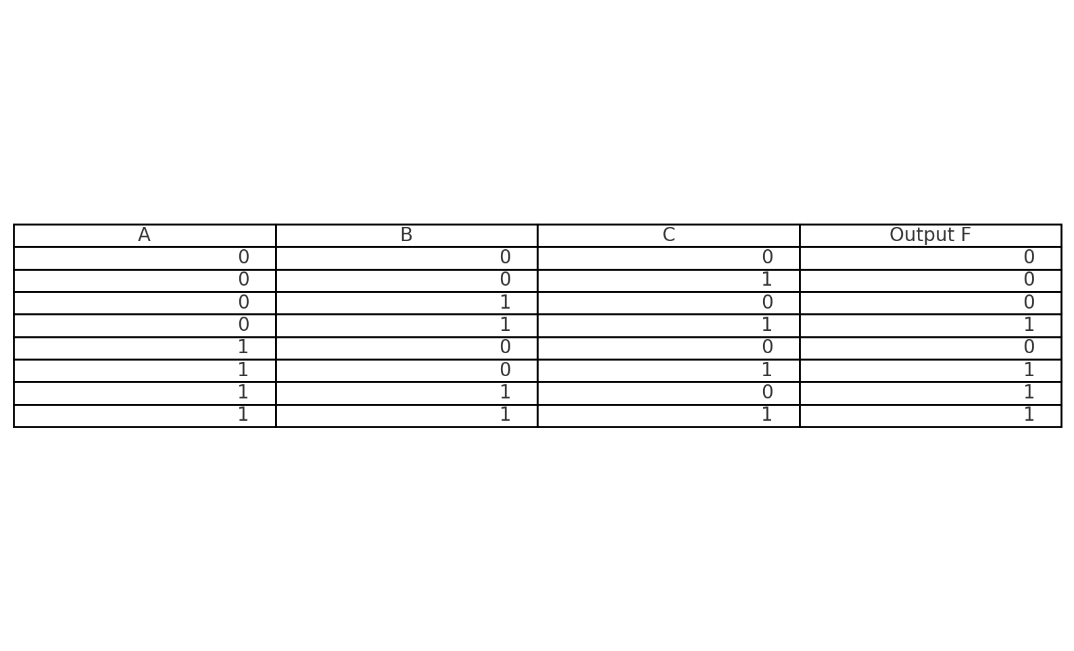
Truth Table
The output is 1 when at least two inputs are 1 (majority votes).

Slide 5
Boolean Simplification
Expression from Truth Table: F = A′BC + AB′C + ABC′ + ABC
Simplified using Boolean Algebra or K-map:
F = AB + BC + AC

Slide 6
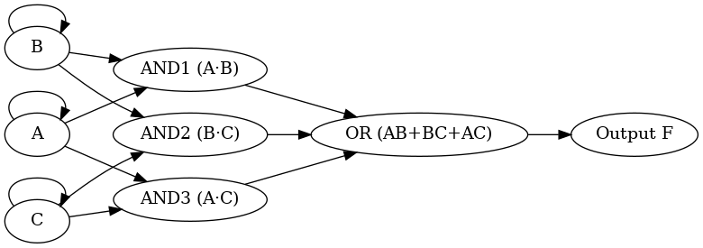
Circuit Diagram
• Three 2-input AND gates: (A·B), (B·C), (A·C)
• Outputs of AND gates are fed to a 3-input OR gate.
• Final output F = AB + BC + AC
• LED indicates the winner (majority votes).

Slide 7
Components Used
Hardware:
• IC 7408 (AND Gate)
• IC 7432 (OR Gate)
• 3 Toggle Switches (Inputs A, B, C)
• 1 LED + Resistor (Output Indicator)
• Breadboard & Wires, 5V DC Supply
Software (Optional): Logisim / Proteus / Tinkercad / Multisim

Slide 8
Working
• Each switch represents a voter.
• When two or more switches are ON (1), the LED glows.
• When fewer than two switches are ON, LED stays OFF.
• This demonstrates the majority voting logic.

Slide 9
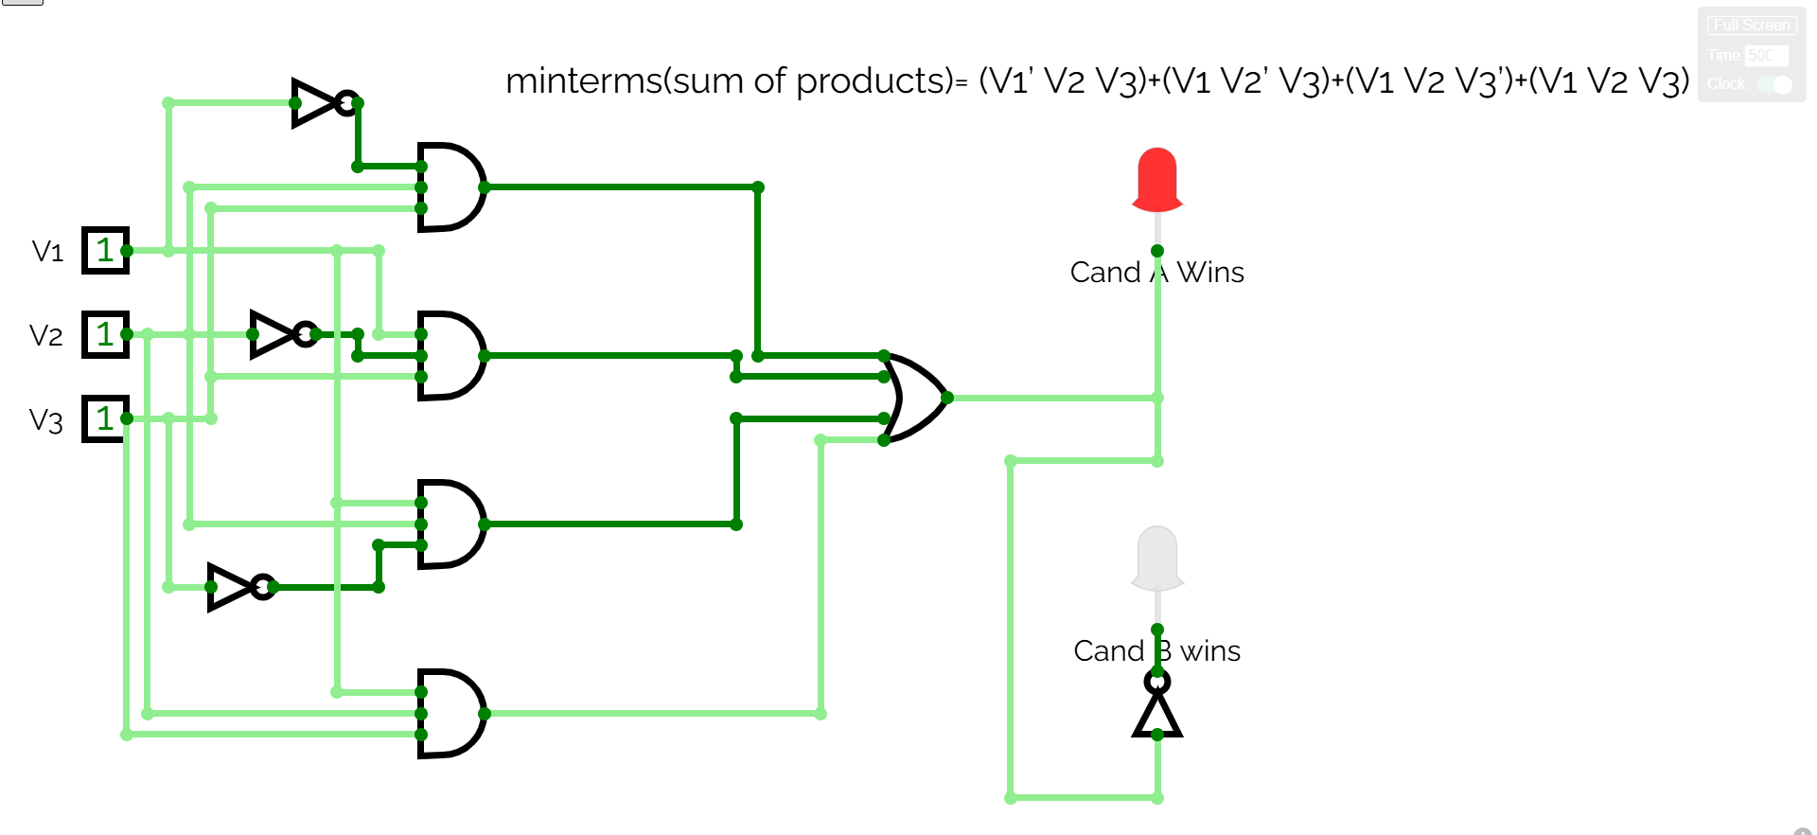
Working model

Slide 10
Conclusion & Future Scope
• Successfully designed a Voting Machine using Boolean simplification.
• Implemented using AND-OR logic gates to find majority output.
• Can be extended to n-voters or microcontroller-based system.
• Demonstrates real-world application of logic gate theory.

Slide 11
References & Acknowledgement
• Digital Logic Design – Morris Mano
• Simulation Tools: Logisim, Tinkercad Circuits
• Guided by: Nazia Hussain
• Presented by: Gitanjali Jain (B243)

